Slide 1
Pakistan In Pursuit of Global Agenda II
Socio-Political Impacts of Pakistan’s Role in Global Peace & Security

Slide 2
What is Global Agenda?
The Global Agenda of Local and Regional Governments for the 21st Century sets out the vision and aspirations of sub-national governments and explains the contributions we can make to ensuring sustainable development in a rapidly changing world.

Slide 3
Pakistan’s Pursuit of the Global Agenda
Pakistan is the world’s sixth most populous nation. Given the young demographic (the median age is 22), it should be well positioned for robust economic growth provided critical steps are taken to improve the country’s human development. The key challenges are insufficient access to quality education, the lack of employment opportunities and limited potential to expand into new market.
Pakistan has displayed commendable commitment to the 2030 Agenda for Sustainable Development as it was one of the first countries to endorse it globally in 2015.

Slide 4
Sustainable development goals & Pakistan
These 17 Goals build on the Millennium Development Goals (MDGs), while including new areas such as climate change, economic inequality, innovation, sustainable consumption, peace and justice, among other priorities. The goals are interconnected; often the key to success on one will involve tackling issues more commonly associated with another.
No poverty
Quality education
Affordable and clean energy
Industry , innovation and infra structure
Climate action
Peace, justice and strong institution
Partnership for the goals

Slide 5
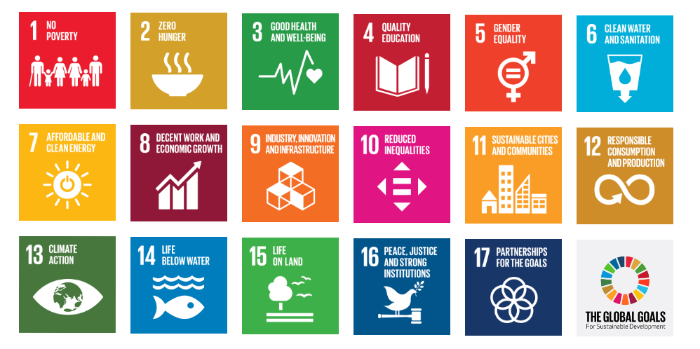

Slide 6
Pakistan has displayed commendable commitment to the 2030 Agenda for Sustainable Development as it was one of the first countries to endorse it globally in 2015.
On 16th February 2016, the Parliament approved the SDGs as the national development agenda. It also formed the Parliamentary SDGs Secretariat based at the National Assembly (one of the few countries to do so)
The process of localizing the SDGs in Pakistan has been more than just agreeing to formal arrangements with government partners. It has also been an inclusive process relying on evidence-based solutions to transform abstract SDG aspirations into real and objective targets for all stakeholders.

Slide 7
MAIN DEVELOPMENTAL GOALS
The SDGs work in the spirit of partnership and pragmatism to make the right choices now to improve life, in a sustainable way, for future generations.
They provide clear guidelines and targets for all countries to adopt in accordance with their own priorities and the environmental challenges of the world at large.
They tackle the root causes of poverty and unite us together to make a positive change for both people and planet. Poverty eradication is at the heart of the 2030 Agenda, and so is the commitment to leave no-one behind.
Dealing with the threat of climate change impacts how we manage our fragile natural resources, achieving gender equality or better health helps eradicate poverty, and fostering peace and inclusive societies will reduce inequalities and help economies prosper.

Slide 8
Role of Pakistan in global peace & security
Global Peace System is a concept of global conflict resolution dependent on nonviolent processes to eradicate war. It relies upon a multi-strand approach to conflict resolution, incorporating broad social and political solutions.
Aims & Objectives
Pakistan's foreign policy seeks to protect, promote and advance Pakistan's national interests in the external domain.
Article 40 of the constitution
The state shall endeavor to preserve and strengthen fraternal relations among muslim countries based on islamic unity.
Support the common interests of the peoples of Asia, Africa and Latin
America promote international peace and security, foster goodwill and friendly relations among all nations and encourage the settlement of international disputes by peaceful means.

Slide 9
MEMBER OF UNITED NATIONs
Pakistan joined UN nation on September 30 1947, a few months of its independence
Over the last 79 years, Pakistan has put this vision into practice by making significant contributions to the principles and purposes of the UN charter.

Slide 10
Pakistan participated in 43 peacekeeping missions in 26 countries, with over 172,000 peacekeepers including 400 women.
A total of 157 Pakistani UN peacekeepers have laid down their lives in the line of duty.
June 5 is commemorated as Pakistani Peacekeepers Day.
Currently, over 7000 Pakistani peacekeepers including more than 6,000 armed forces personnel; over 70 military experts; around 66 staff officers; UN peacekeeping missions.
Pakistan is signatory to a large number of UN and international conventions related to global peace and prosperity.
Pakistan provides leadership and useful policy contributions for several issues faced by humanity, from human rights to the environment.

Slide 11
CIPS (Center of International peacekeeper Stability)
In 2013, Pakistan established CIPS in Islamabad
Inaugurated by then UN Secretary General, Ban Ki-Moon.
Its aim to train peacekeeper in research and acadamia.

Slide 12
Geo Strategic problems
Pakistan’s superior geo-strategic location comes with a range of challenges
Bridging the Middle East, Europe, and Asia
Indian-administered Kashmir is highly significant in global security landscape.

Slide 13
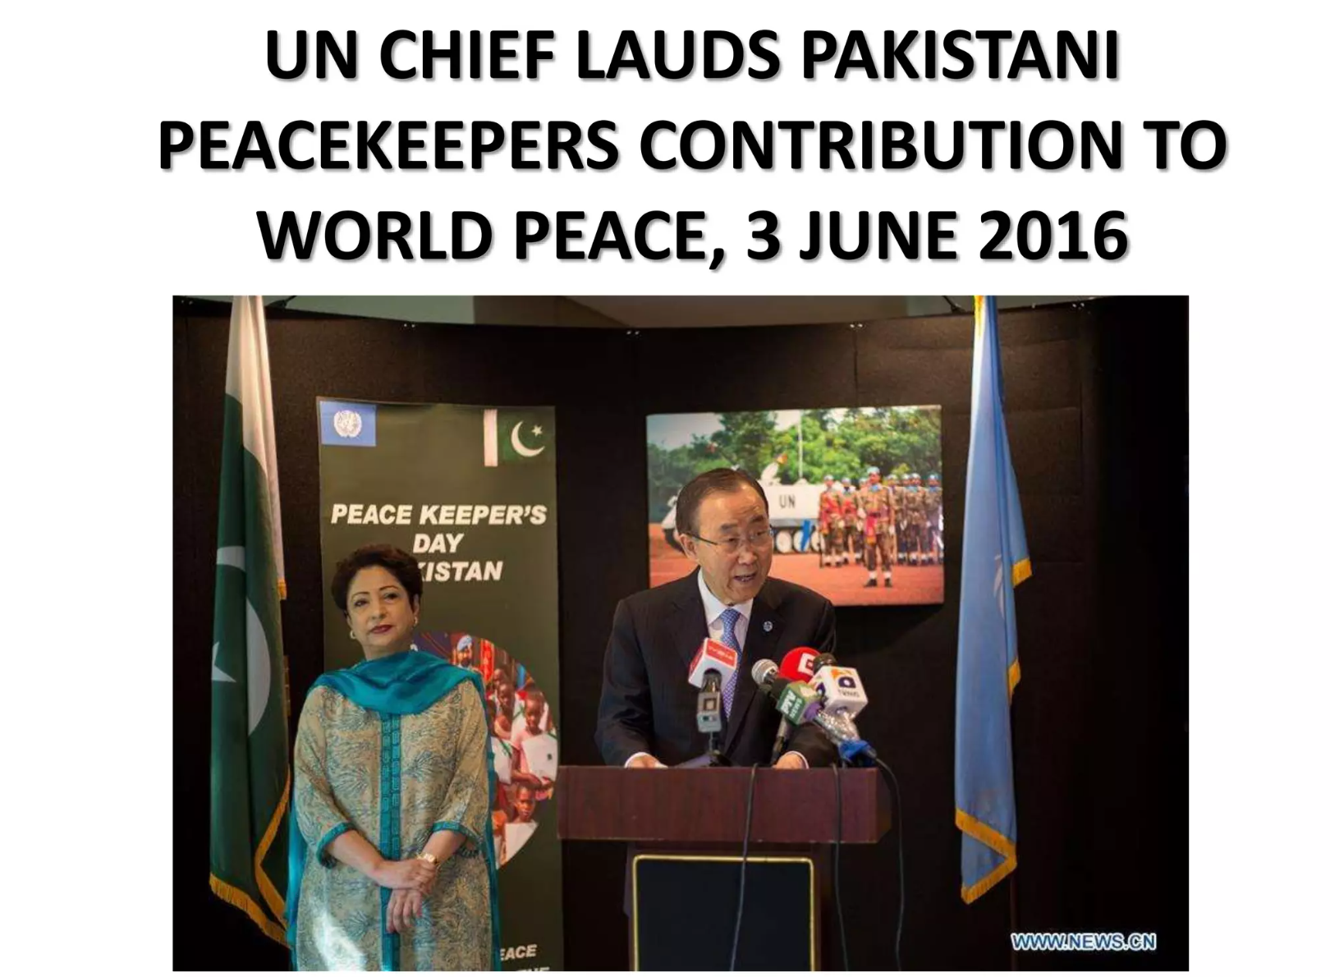
Unfairly portrayed in world media
It is at its heart full of inspiring and phenomenal people
Charles Leadbeater, in an article in the Financial Times once wrote:
“There are hidden forces at work in Pakistan that hold it together and offer it a better future. When government and partners work creatively with these forces, amazing things can happen.”

Slide 14
Conceptual Framing
Pakistan’s participation in peacekeeping reflects a strategic blend of national interest and normative commitment to collective security under UN
Peacekeeping simultaneously functions as an instrument of foreign policy and global visibility.
From a liberal institutionalist perspective, Pakistan strengthens multilateral cooperation through sustained troop contributions.
From a realist lens, participation enhances strategic leverage and international bargaining power.
Constructivist interpretations suggest that peacekeeping shapes Pakistan’s identity as a responsible and peace-oriented state.
Pakistan’s peacekeeping role operates at the intersection of moral obligation and geopolitical calculation.

Slide 15
Scale and Strategic Depth of Contribution
Pakistan’s status as one of the largest troop contributors signals long-term institutional commitment rather than symbolic engagement.
Deployment in regions such as Democratic Republic of the Congo, Liberia, Sierra Leone, Sudan, and South Sudan places Pakistan within complex post-conflict environments that test institutional resilience.
Sustained engagement enhances operational credibility in high-risk zones.
High troop contributions do not automatically translate into proportional political influence within UN decision-making bodies.
This imbalance reflects structural inequalities in global governance.
Pakistan contributes extensively at the operational level but remains constrained at the strategic policy level.

Slide 16
Impact on Global Peace Architecture
Pakistan’s peacekeepers contribute to ceasefire monitoring, civilian protection, and stabilization in fragile states.
These efforts reinforce the legitimacy of multilateral peace enforcement mechanisms.
By preventing conflict relapse, Pakistan indirectly supports global economic and political stability.
Peacekeeping missions often operate within mandates limited by geopolitical rivalries among major powers.
Pakistan’s effectiveness is partly shaped by broader power politics within the international system.
This highlights the structural limitations of peacekeeping as a tool of global governance.

Slide 17
Enhancement of International Reputation
Peacekeeping strengthens Pakistan’s image as a constructive global actor despite regional security challenges.
It functions as a soft power resource that improves diplomatic standing in multilateral forums.
The humanitarian narrative associated with peacekeeping counters stereotypes linking Pakistan solely to conflict zones.
Global recognition often remains limited compared to major powers with smaller troop contributions but larger financial stakes.
This disparity reveals the political hierarchy embedded within international institutions.
Reputational gains exist but are moderated by structural power asymmetries.

Slide 18
Domestic Institutional & Military Implications
Participation enhances professional competence, interoperability, and strategic exposure of Pakistan’s armed forces.
Experience in multinational coordination strengthens crisis response capabilities.
Peacekeeping fosters modernization in training and doctrine development.
Extended deployments can strain domestic security resources.
The dual burden of internal counterterrorism and external peacekeeping requires careful strategic balance.
Institutional gains must be weighed against opportunity costs at the domestic level.

Slide 19
Social and Identity-Based Impacts
Peacekeeping fosters a narrative of Pakistan as a humanitarian contributor rather than merely a security consumer.
The sacrifices of peacekeepers generate collective national pride and symbolic unity.
The participation of female peacekeepers challenges traditional gender roles within security institutions.
Identity construction through peacekeeping remains influenced by internal political discourse.
Social impacts are significant but not uniformly interpreted across society.

Slide 20
Political & Diplomatic Outcomes
Peacekeeping creates diplomatic goodwill with host states and other troop-contributing countries.
Engagement enhances Pakistan’s bargaining capacity in multilateral negotiations.
It provides indirect support for Pakistan’s advocacy on issues of sovereignty and non-intervention.
Peacekeeping does not guarantee support for Pakistan’s core geopolitical concerns.
Diplomatic dividends are therefore situational rather than automatic.
This demonstrates the complexity of translating military contribution into political capital.

Slide 21
Economic & Strategic Evaluation
UN reimbursements provide financial compensation, yet they represent limited economic incentive compared to operational risks.
Strategic visibility gained through peacekeeping enhances Pakistan’s defense diplomacy profile.
Participation signals reliability as a security partner in global conflict management.
However, financial gains remain secondary to strategic and reputational objectives.
The human cost of casualties underscores the tangible sacrifices involved.
The economic dimension is supplementary rather than primary in motivation.

Slide 22
Structural Challenges & Global Inequality
Pakistan’s extensive operational contribution contrasts with limited representation in elite global decision-making structures.
Structural inequalities within the UN Security Council constrain influence for troop-contributing states.
Peacekeeping exposes personnel to asymmetric warfare and evolving non-state threats.
Mandate limitations sometimes restrict the ability to fully resolve conflicts.
These constraints highlight the tension between operational commitment and political authority.
Pakistan’s role illustrates both the strengths and limits of middle-power engagement in global governance.

Slide 23
Peacekeeping as Strategy, Identity & Diplomacy
Pakistan’s peacekeeping participation reflects a strategic fusion of moral commitment and national interest.
It enhances diplomatic credibility while simultaneously serving institutional and strategic objectives.
Socio-political benefits are substantial but shaped by global power hierarchies.
Domestic institutional gains coexist with resource and security trade-offs.
Reputational improvements are meaningful yet structurally moderated.
Pakistan’s engagement demonstrates how middle powers navigate global peace architecture to balance responsibility with strategic ambition.

